Slide 1

Books Market Analysis using Web Scraping & Exploratory Data Analysis (EDA)
Presented by:
Ramya KYPA

Slide 2
About me
MCA Graduate (2025)
Aspiring Data Analyst
Skilled in Python, SQL, Power BI, Pandas & Web Scraping
Passionate about solving business problems using data
www.linkedin.com/in/ramya-kypa-a01969409
ramyakypa345-ctrl

Slide 3
Agenda
Objective of the Project
Dataset Collection
Data Cleaning & Preparation
Exploratory Data Analysis
Key Business Insights
Recommendations
Conclusion
Challenges

Slide 4
Problem Statement & Objective
Website
↓
Web Scraping
↓
Data Collection
↓
Data Cleaning
↓
EDA
↓
Business Insights
Problem Statement
Online bookstores contain thousands of books with different prices, ratings and availability. Analysing this data manually is difficult and time-consuming.
Objective
Collect book information using Web Scraping.
Clean and preprocess the dataset.
Analyse book prices and ratings.
Understand category-wise distribution.
Generate business insights for better decision-making.

Slide 5
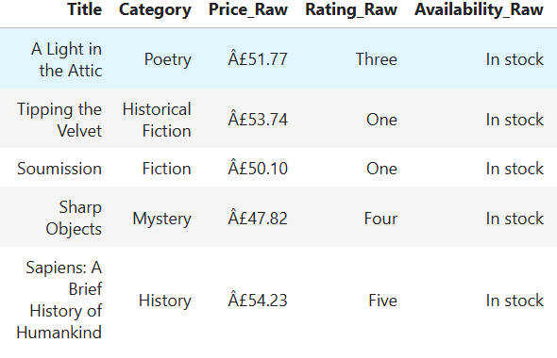
Dataset Collection
Data Source
Books to Scrape (http://books.toscrape.com)
Technologies Used
Python – Programming language
Requests – Fetch HTML content from the website
Beautiful Soup – Parse HTML and extract book information
Pandas – Store, clean, and manipulate the dataset
Matplotlib – Create charts and graphs
Seaborn – Generate advanced statistical visualizations
Data Collected
Book Title
Price
Rating
Availability
Category

Slide 6
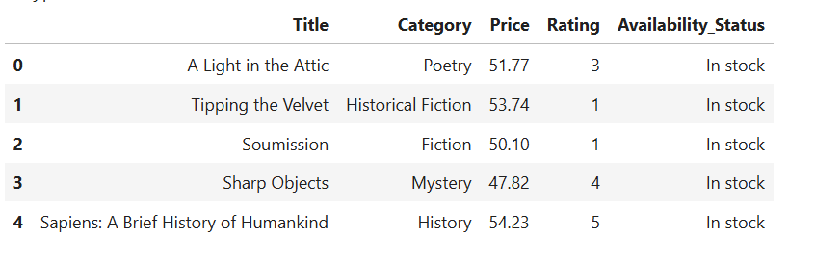
Data Cleaning & Preparation
Data Cleaning Process
Removed duplicate book records.
Checked for missing (null) values.
Converted Price from text to numeric format.
Converted Star Ratings (One, Two, Three, Four, Five)
into numerical values (1–5).
Extracted Category information for each book.
Standardized column names and text values.
Created a clean dataset ready for analysis.

Slide 7
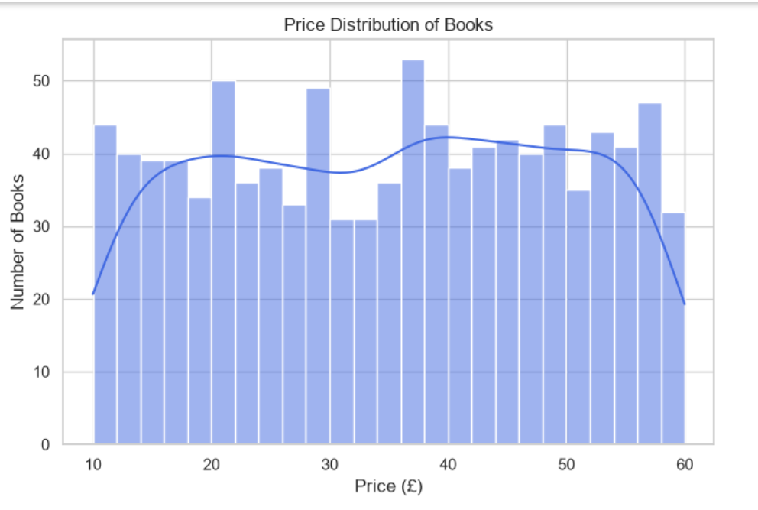
Exploratory Data Analysis: Price Distribution
Objective
Analyse the distribution of book prices to understand
the pricing pattern in the online book market.
Observations
Most books are concentrated in the low and medium price ranges.
Only a few books are available in the high-price range.
The distribution helps identify the most common selling price of books.
Business Insight
Affordable books dominate the market.
Publishers and retailers can focus on competitive pricing to attract more customers.
Price analysis helps understand customer purchasing trends.

Slide 8
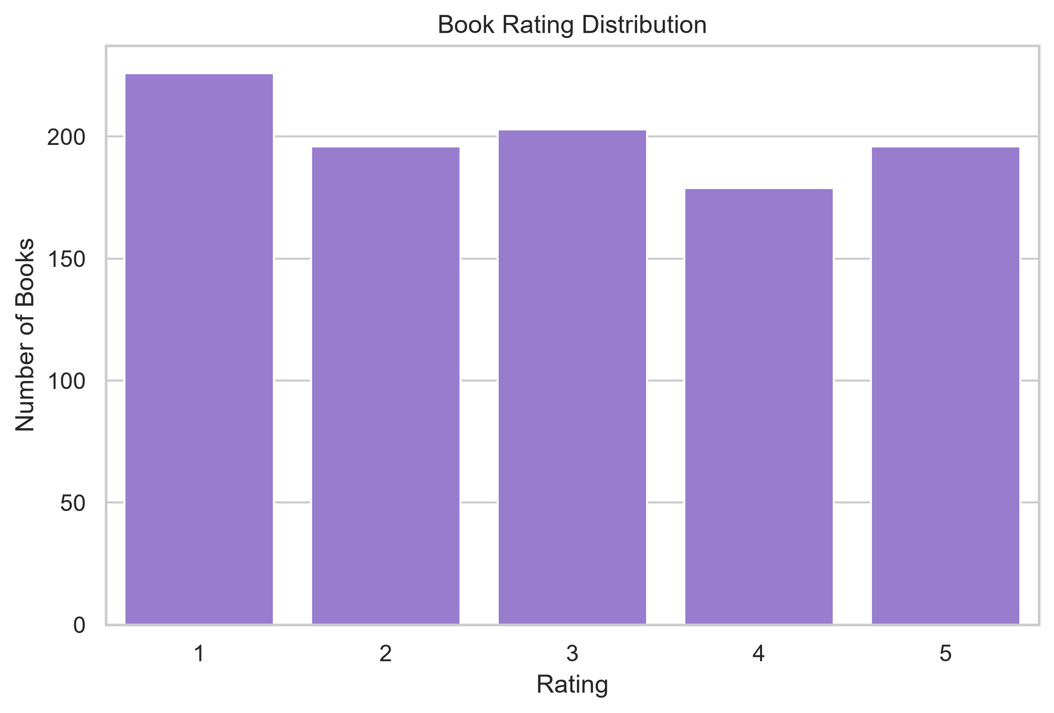
Rating Distribution Analysis
Objective
To analyse the distribution of customer ratings and
understand the overall quality of books available in
the online bookstore.
Observations
Books are rated on a 1 to 5-star scale.
Most books have 3-star and 4-star ratings.
A smaller number of books have 1-star or 5-star ratings.
The ratings provide an overview of the quality and popularity of books.
Business Insights
Books with higher ratings are more likely to attract customers.
Highly rated books can be recommended or promoted to increase sales.
Lower-rated books may require better visibility, pricing strategies, or quality improvements.

Slide 9
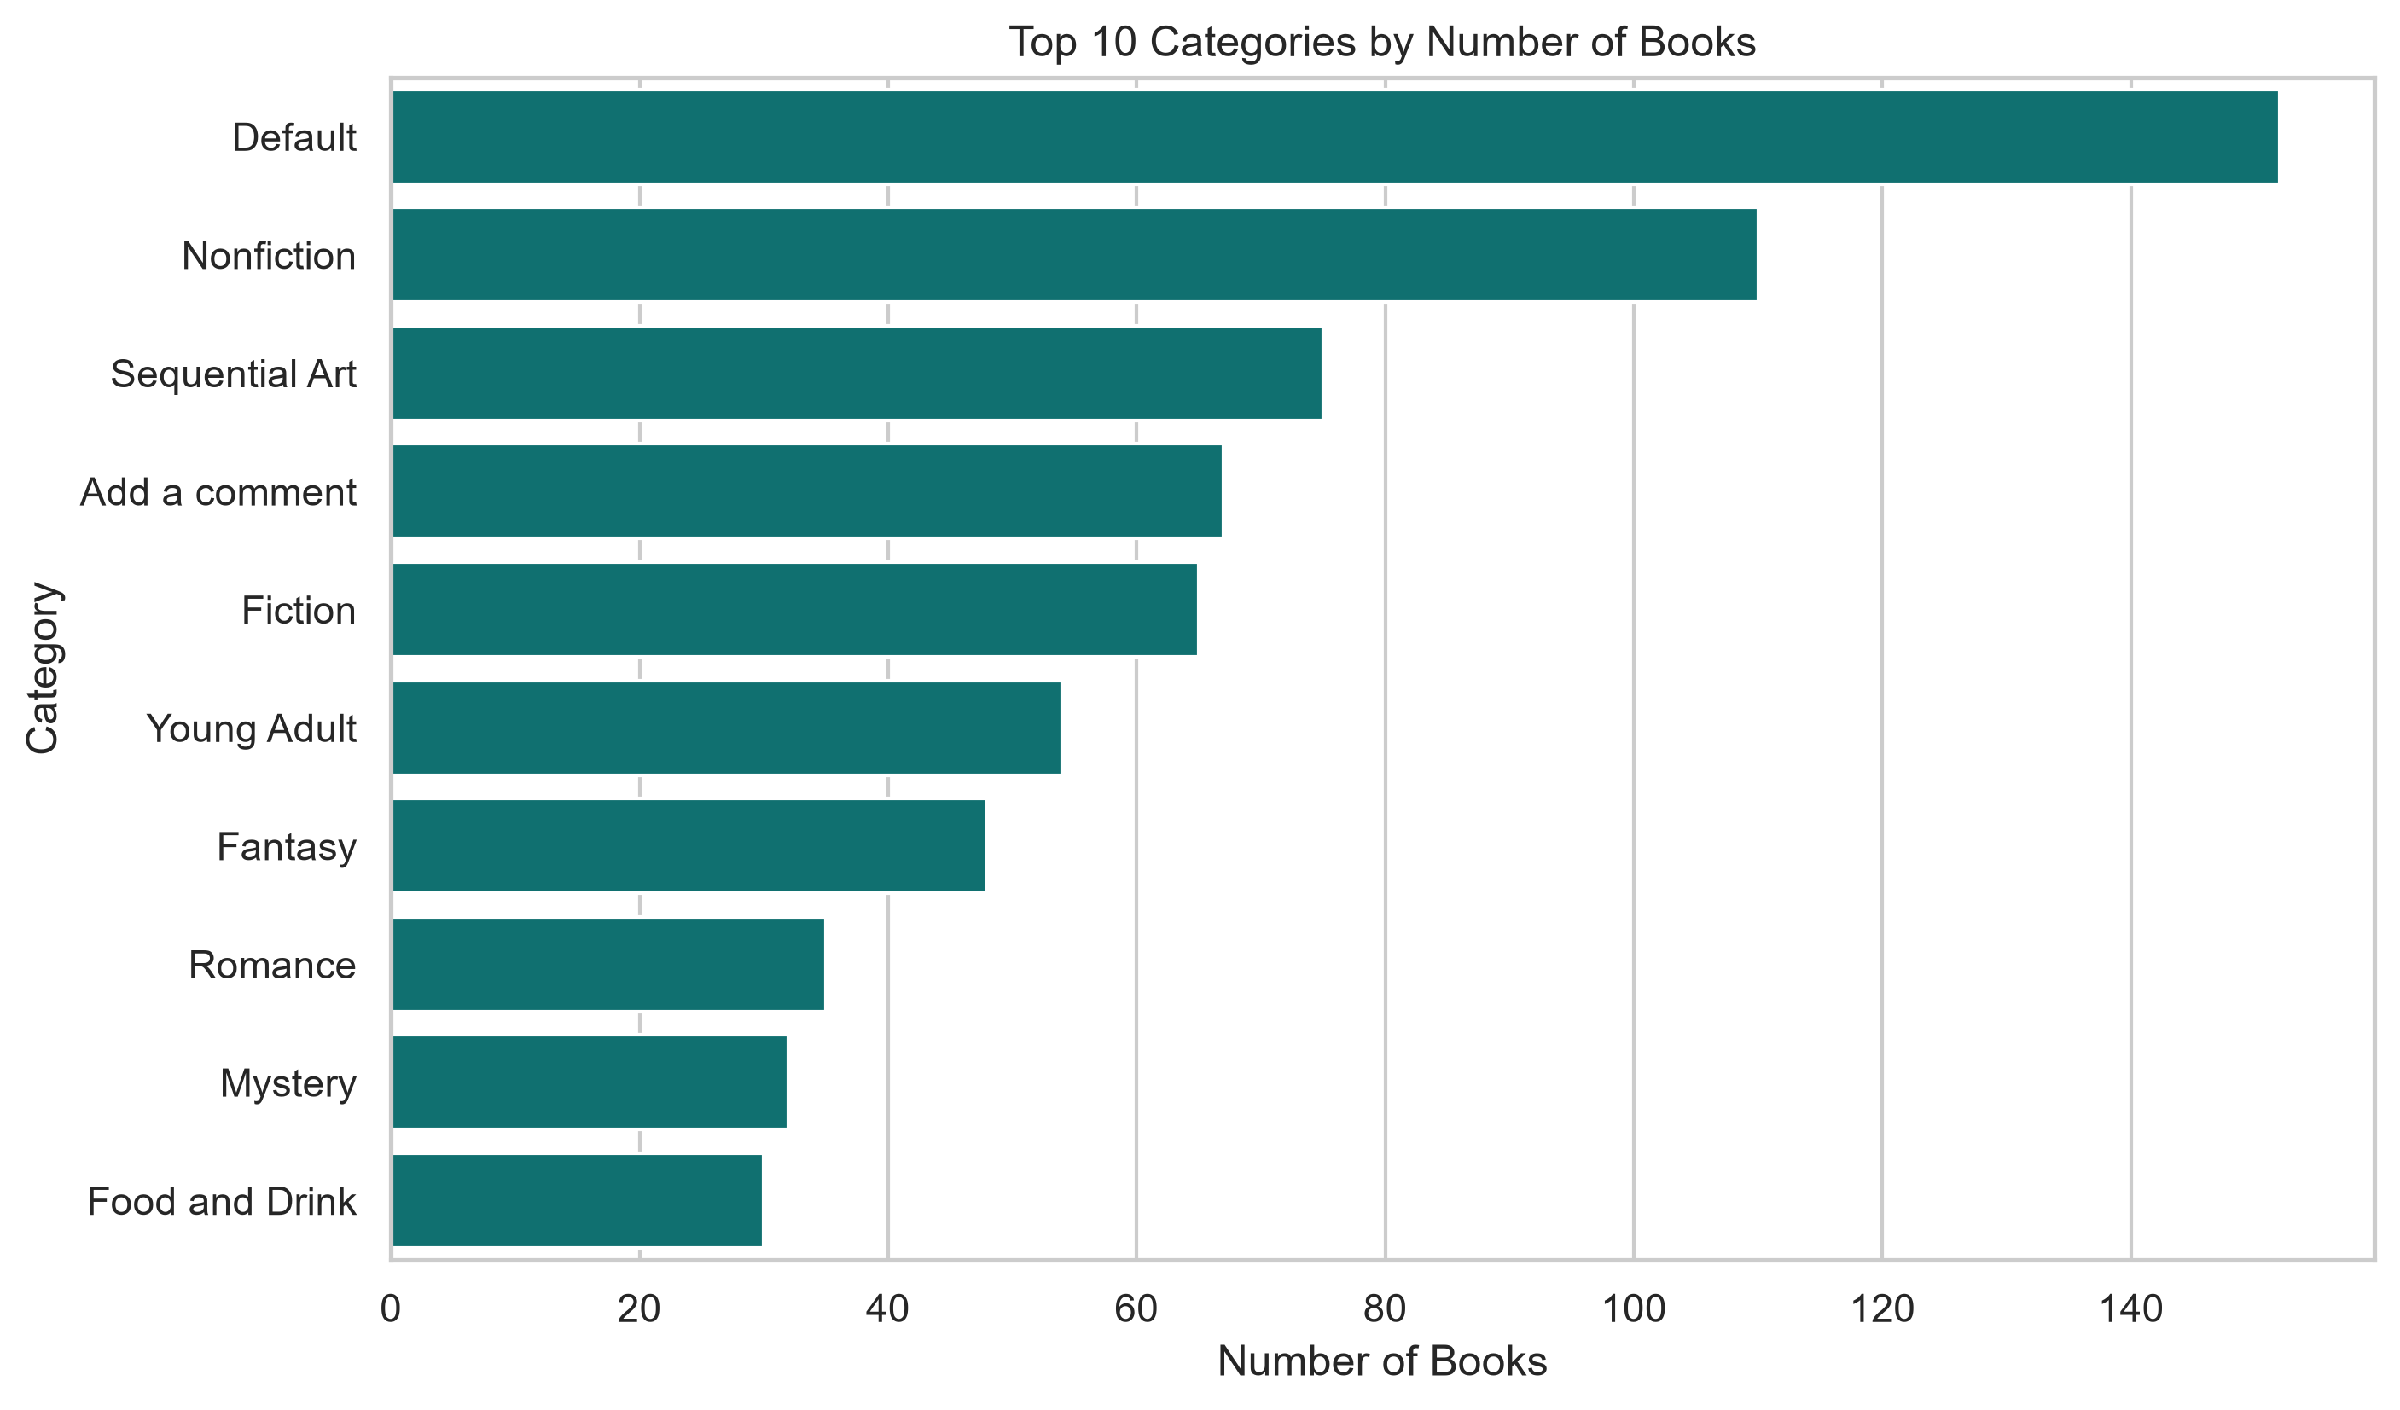
Category Analysis
Objective
To analyse the distribution of books across different
categories and identify the categories with the highest
number of books.
Observations
Books are grouped into multiple categories such as Fiction,
Mystery, Travel, History, Science, and others.
Some categories contain significantly more books than others.
The distribution highlights the categories with the largest collection of books.
Business Insights
High-volume categories indicate greater product availability and customer interest.
Retailers can focus on popular categories to improve sales and inventory planning.
Understanding category distribution helps in making better marketing and stocking decisions.

Slide 10
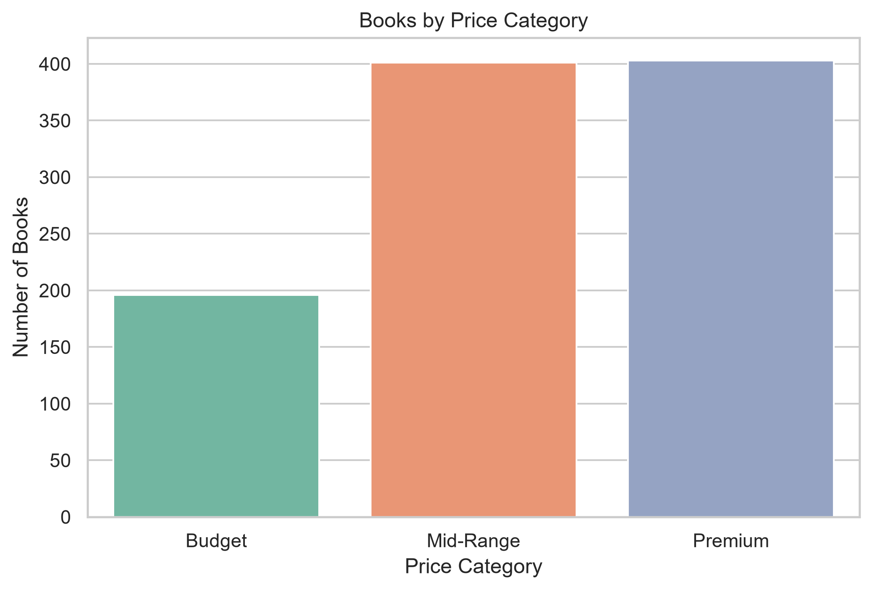
Books by Price Category
Objective
To classify books into Budget, Mid-Range, and
Premium categories and understand their distribution.
Observations
Budget books have the lowest count.
Mid-Range and Premium books have almost equal numbers.
Most books belong to the Mid-Range and Premium price segments.
Business Insights
Customers have a wide selection of books in the Mid-Range and Premium categories.
Retailers can maintain a balanced inventory across these price segments.
Budget books represent a smaller portion of the catalog.

Slide 11
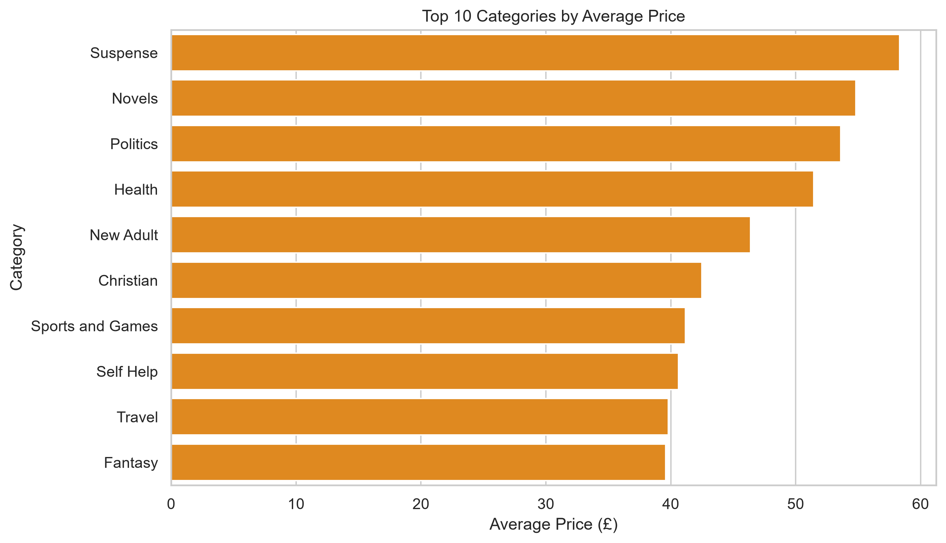
Top 10 Categories by Average Price
Objective
To identify which book categories have the highest
average selling price.
Observations
Suspense has the highest average price.
Novels and Politics also have relatively high average prices.
Fantasy and Travel have lower average prices among the top ten.
Business Insights
Premium-priced categories can generate higher revenue per book.
Pricing varies across genres, allowing retailers to adopt category-specific pricing strategies.
High-priced categories may require targeted marketing.

Slide 12
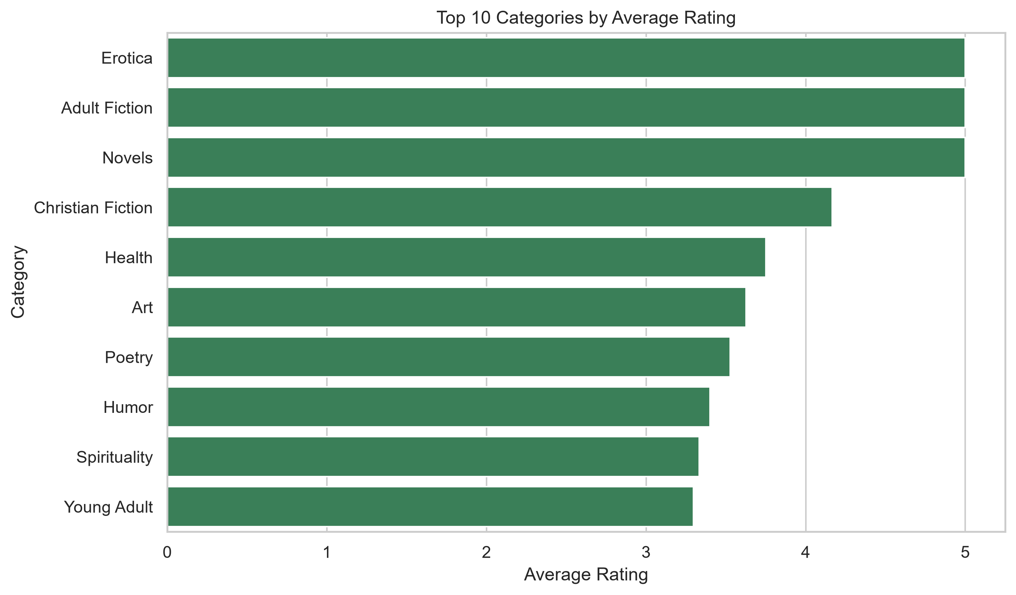
Top 10 Categories by Average Rating
Objective
To identify the categories that receive the highest customer
ratings.
Observations
Erotica, Adult Fiction, and Novels have the highest
average ratings.
Most of the top-rated categories have an average
rating above 4 stars.
Readers generally rate these categories positively.
Business Insights
Highly rated categories indicate strong customer satisfaction.
These categories can be recommended to improve customer engagement and sales.
Businesses can promote highly rated genres to attract more readers.

Slide 13
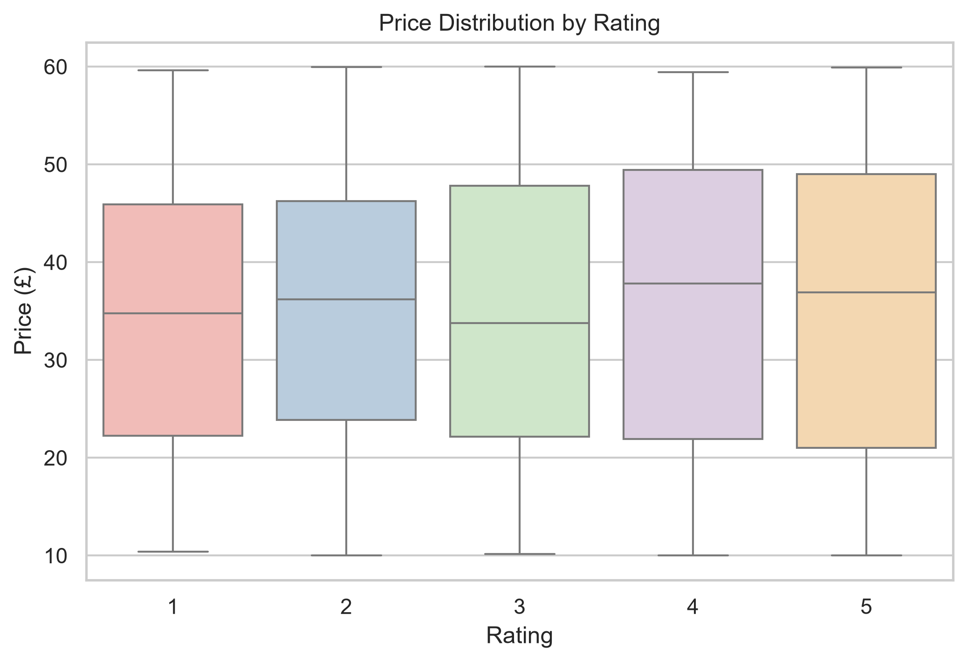
Price Distribution by Rating
Objective
To analyse how book prices vary across different rating levels.
Observations
The price ranges are similar across all rating levels.
Books with higher ratings are not always more expensive.
The median prices are relatively consistent across ratings.
Business Insights
Book price does not strongly influence customer ratings.
Customers appear to value the content and quality of books more than their price.
Businesses should focus on improving book quality rather than increasing prices.

Slide 14
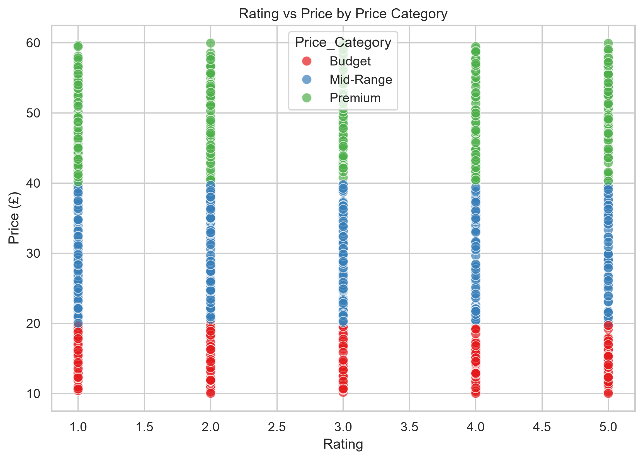
Rating vs Price by Price Category
Objective
To examine the relationship between book ratings,
prices, and price categories.
Observations
Books from all price categories are distributed across
every rating level.
High-rated books exist in Budget, Mid-Range, and Premium
segments.
There is no strong correlation between price and rating.
Business Insights
Customers can find highly rated books at every price level.
Premium pricing does not guarantee better ratings.
Retailers should focus on maintaining quality across all price segments.

Slide 15
Key Business Insights
Pricing Insights
Most books belong to the Mid-Range and Premium price categories.
Budget books represent a smaller portion of the overall collection.
Customer Rating Insights
Highly rated books are available across all price categories.
Higher prices do not necessarily result in better customer ratings.
Category Insights
Suspense has the highest average book price.
Erotica, Adult Fiction, and Novels have the highest average ratings.
Overall Insight
Customers value book quality and content more than price.
Both pricing strategy and customer ratings should be considered when recommending books.

Slide 16
Recommendations
Increase inventory for high-rated, fast-selling categories.
Promote affordable books with 4- and 5-star ratings.
Offer discounts on expensive books with lower ratings.
Bundle books from popular categories to increase sales.
Focus marketing campaigns on categories with strong customer satisfaction.

Slide 17
Conclusion
Successfully collected book data using Web Scraping with Python and Beautiful Soup.
Cleaned and transformed the dataset for accurate analysis.
Performed Exploratory Data Analysis using Pandas, Matplotlib, and Seaborn.
Identified pricing patterns, customer rating trends, and category-wise performance.
The project demonstrates how web scraping and data analytics can support data-driven business decisions in the online book market.

Slide 18
Challenges Faced
Extracting data from multiple web pages.
Parsing HTML elements accurately using Beautiful Soup.
Cleaning and transforming raw scraped data.
Converting text-based ratings into numerical values.
Creating meaningful visualizations for business analysis.
Interpreting the results to generate actionable business insights.

Slide 19

THANK YOU

